Slide 1
The Data Cards Playbook
Create purposeful, transparent, and people-centric dataset documentation
https://pair-code.github.io/datacardsplaybook/ #datacardsplaybook

Slide 2


Introduction
01 Ask 02 Inspect
03 Answer
04 Audit

Slide 3
Questions with Optics
Facilitator’s note
This is a basic activity to enforce structure and relationships into questions that will be included in your Data Card(s).
Delete this note once you’re done with it.
THE DATA CARDS PLAYBOOK
Learn how to frame questions that can be used on a broad class of datasets to support agents in their information journeys.

Slide 4
Understand the difference between Telescopic, Periscopic, and Microscopic Questions and enforce structure and relationships into questions to include in your Data Card(s).
Questions that agents might ask to arrive an understanding of the dataset to include in your Data Cards.
Basic

Slide 5

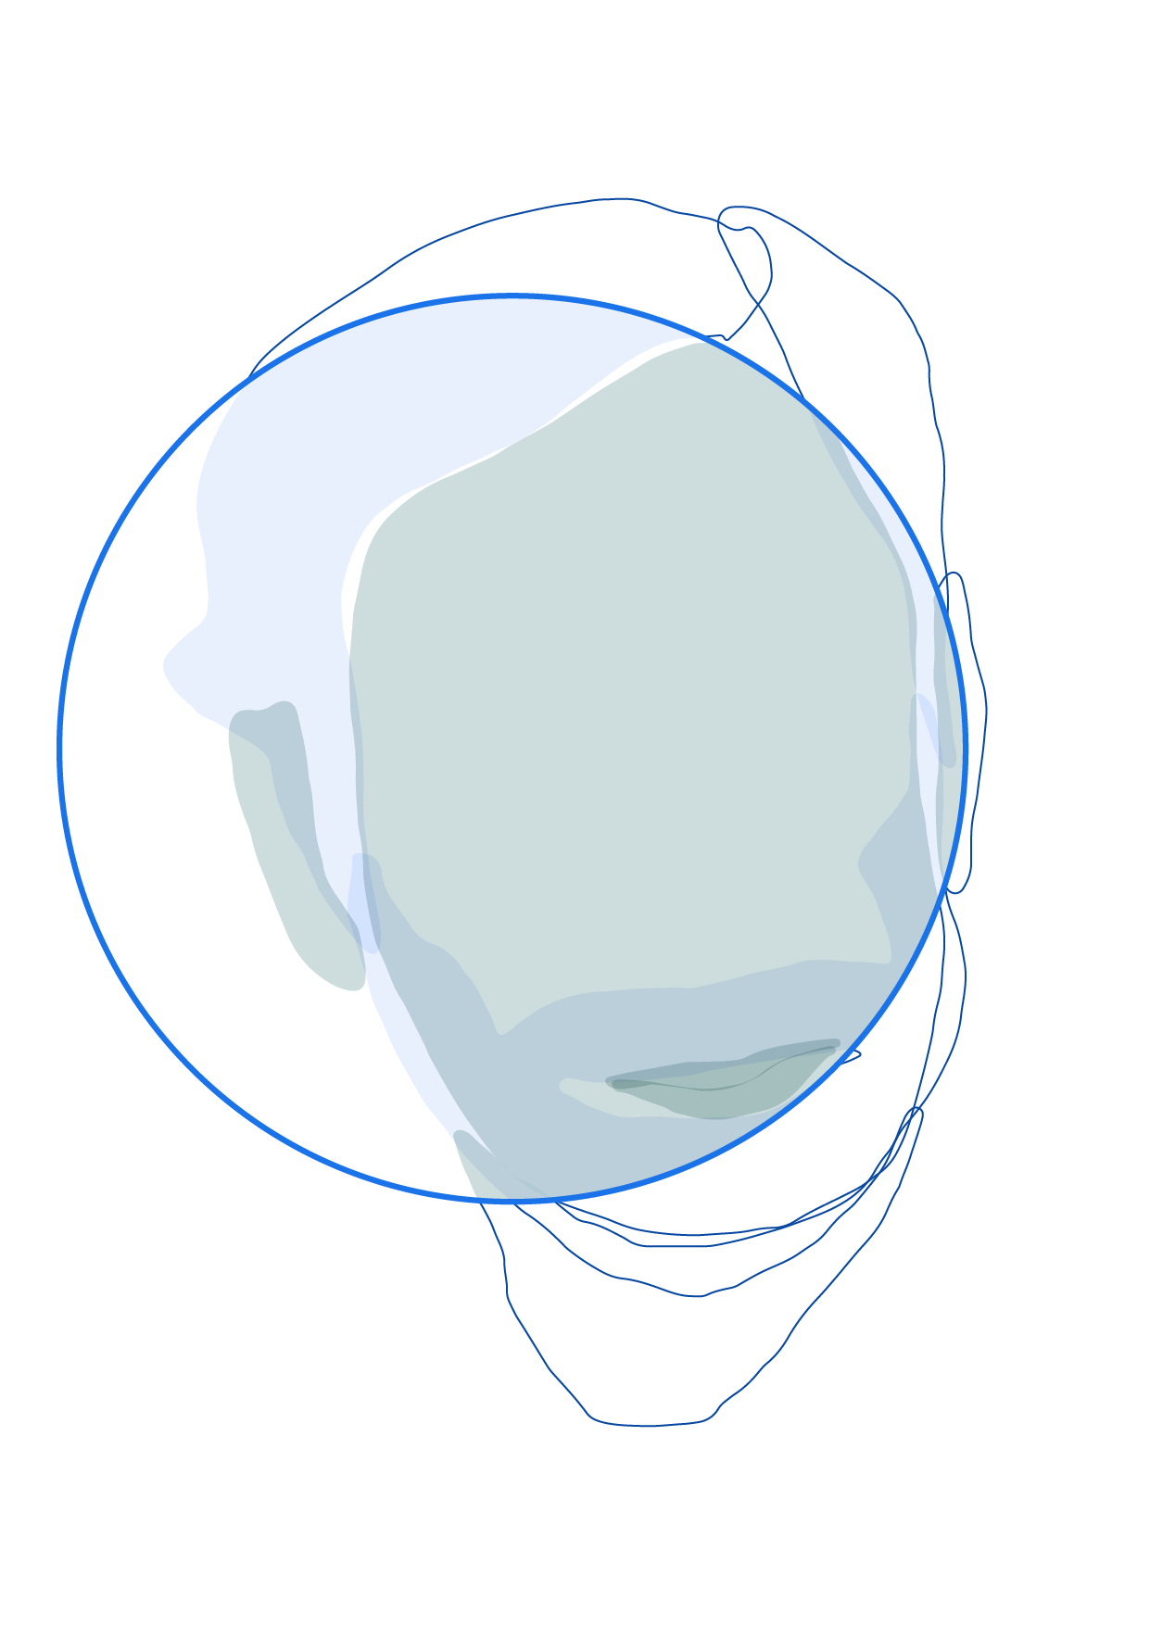
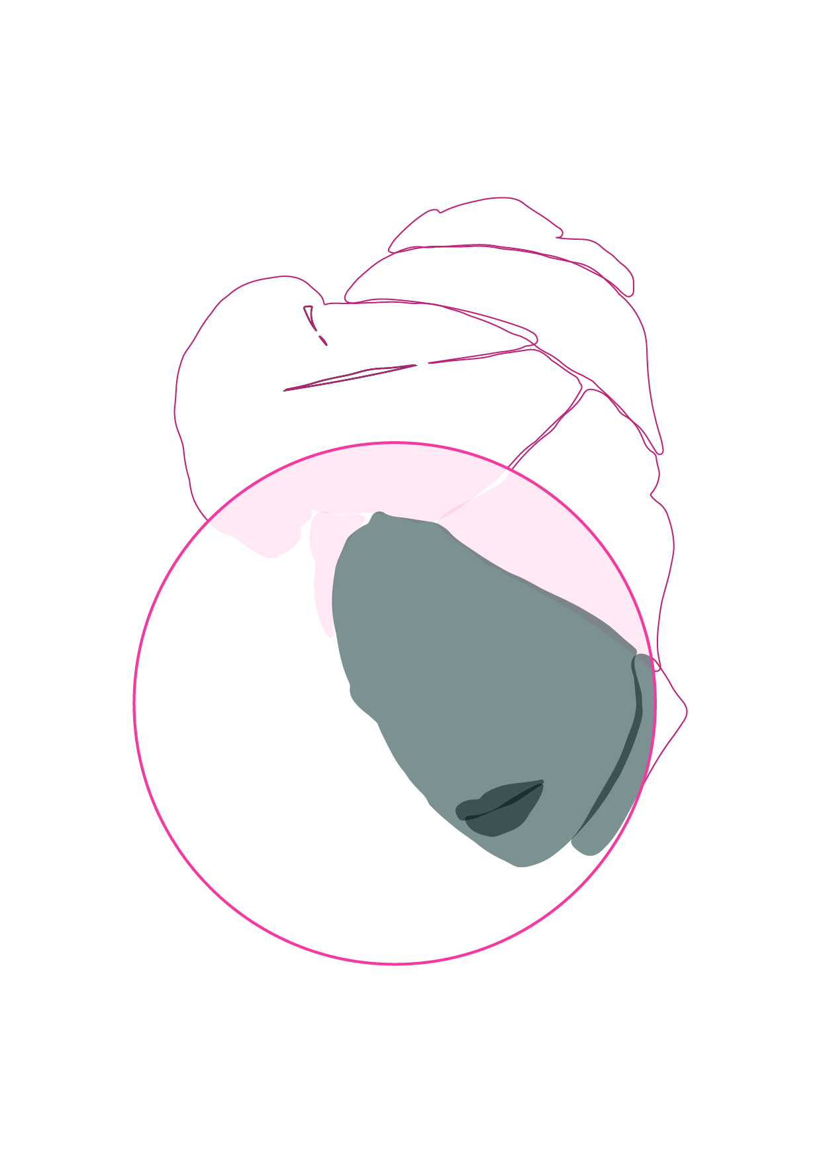
Ask a series of questions in succession to make sense of datasets.
Use “Scopes” to frame questions and reveal obvious, non-obvious, visible, and invisible aspects of datasets. Scopes occur in sets of three: telescopic, periscopic, and microscopic.
Notes:
Scopes are a metaphor to focus and frame questions and reveal obvious, non-obvious, visible and invisible aspects of datasets.
In optics, scopes use lenses (and mirrors) for spotting, observation, magnification, reflection, and even testing materials.
By stacking scopes of different granularities, we create content that helps agents establish a cohesive understanding of datasets through transparency reports.

Slide 6



Types of scopes
Telescopic
Questions about attributes or characteristics commonly found across multiple datasets.
For example: Does this dataset contain S/PII?
Data Cards with just telescopes will describe obvious and not add any distinct value, but telescopes tell agents where to begin looking.
Periscopic
Questions about attributes or observations specific to the dataset being documented.
For example: Which features in the dataset contain S/PII?
Data Cards with just periscopes can get overly technical, without any details on context, relevance, or importance.
Microscopic
Questions about unobservable aspects of dataset(s), such as decisions, processes, impact.
For example: How was S/PII handled in this dataset?
If we only use microscopes, we can easily get lost in the details, and lose sight of the bigger picture.

Slide 7
Case in point:
EXAMPLE
TELESCOPIC
(global attributes)
(What is the type of Data in the Dataset?)
Primary Data Type
Tabular, Image, Audio, Speech, Time-series, Network, Graph, etc.
PERISCOPIC
(local observations, demands evidence)
(What is the breakdown of the data in the Dataset?)
Total Instances 478k+
Total Classes 6k+
Total Labels 1.27m+
Algorithmically Generated Labels 1.11m+
User Contributed Labels 505k+
Human Verified Labels All labels verified
... ...
MICROSCOPIC
(unobservable explanations, demands rationale)
(What does the data in the Dataset describe?)
Nature Of Content Labeled images of objects (household goods, commercial products), vehicles, plants, animals and people (faces blurred).
(How was data included or excluded in the Dataset?)
Excluded Data All EXIF data including location has been removed.
(How was PII handled in the Dataset?) Privacy PII associated with human subjects removed where possible. To preserve demographic context, features are aggregated using ...

Slide 8
Facilitator’s note
This slide is a handy comparison of the different types of scopes. You can choose to include in your presentation as a reference for participants.
Delete this note once you’re done with it.
 | TELESCOPIC | PERISCOPIC | MICROSCOPIC
Description | Characteristics | Observations | Explanations
Input Type | Yes/No or multiple choice responses | Key-Value pairs or short descriptions | Detailed, long-form descriptions
Format | Tags, Chips | Text, Tables, and Visualizations w/ Links | Paragraphs, Tables, Visualizations, Links
Content | Universal attributes of datasets | Unique, observable characteristics of the dataset | Rationales, decisions, and policies that shape datasets
Utility | Find information quickly; Indexical – search or scan Keywords, descriptors | Facilitate quick assessments Tactical – what statements | Provide context and links to additional information Rationale and process – why and how statements
Value | Provide an overview and help habituate agents in the Data Card. Make Data Cards easy to index in repositories | Often reproducible from the dataset, prevent re-work, and add more context for agents when stacked | Unobservable attributes and considerations important to agents, but accessible only to producers

Slide 9
As a data scientist, I want to know about the structure of the dataset, so I ask…
… what is the data format? … are there any media in the dataset?
… how many features are in the dataset? … how many features are engineered?
… which features are strongly correlated and why? Was this intentional?
EXAMPLE
Facilitator’s note
Here’s an example of a completed AIJ, with clearly established scopes. You can choose to include in your presentation as a reference for participants.
Delete this note once you’re done with it.
telescopic
periscopic
microscopic

Slide 10
Try it yourself
As a [your perspective], I want to know about the source(s) of the dataset, so I ask…
… _______________________?
… _______________________?
… _______________________?
30
sec
Facilitator’s note
This is a prompt-based modelling activity. It helps prepare participants for the next brainstorm.
Ask participants to frame their own agent information journeys and share it with the room, by typing or simply speaking.
Delete this note once you’re done with it.
perspective
lenses
Ask about attributes
telescopic question
Follow-up: Ask for evidence
periscopic question
Follow-up: Ask for rationale
microscopic question
Notes:
Model expectations ahead of the brainstorm: Ask participants to frame their own agent information journeys, focusing on scopes, and share it with the room to get comfortable with the upcoming activity.

Slide 11
Give structure to your scopes
15
min
Facilitator’s note
Duplicate this slide as needed. Refer to the speaker notes for details on how to fill this sheet. We recommend involving individuals who are representative of agents when filling this out.
Skip this activity if you plan to go through the scopes brainstorm.
Delete this note once you’re done with it.
✍️ As a(n) [perspective], I want to know [lens]
Telescopic Question: ✍️
Expected Answers:
Periscopic Question: ✍️
Expected Answers:
Microscopic Question: ✍️
Expected Answers:
✍️ As a(n) [perspective], I want to know [lens]
Telescopic Question: ✍️
Expected Answers:
Periscopic Question: ✍️
Expected Answers:
Microscopic Question: ✍️
Expected Answers:
✍️ As a(n) [perspective], I want to know [lens]
Telescopic Question: ✍️
Expected Answers:
Periscopic Question: ✍️
Expected Answers:
Microscopic Question: ✍️
Expected Answers:
Notes:
Recommended duration: 15 minutes per worksheet or 5 minutes per lens. Cycle through all lenses
Pro-tip: Focusing on establishing connections between scopes. Think about the types of answers you might expect.

Slide 12
Checklist
YOU SHOULD NOW BE
_
Familiar with the differences between scope types
Able to break lenses down into sets of questions
Have agreed upon your scopes and the expected answers
Ready for the scopes brainstorming section
✔
✔
✔
✔

Slide 13

#datacardsplaybook
The Data Cards Playbook ↗ is an adaptable toolkit of participatory activities, conceptual frameworks, and guidance that support Responsible AI practices for transparency in dataset documentation.
If you’ve adapted, implemented, or have feedback for this guidance, we’d love to hear from you at https://github.com/pair-code/datacardsplaybook ↗.
Find the complete playbook at https://pair-code.github.io/datacardsplaybook ↗

Slide 14

The Data Cards Playbook ↗ by the People + AI Research Initiative ↗ at Google Research ↗ is licensed under a Creative Commons Attribution-ShareAlike 4.0 International License. You are free to share and adapt this work under the appropriate license terms ↗.

